Slide 1
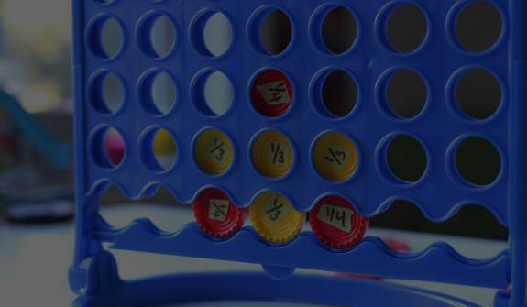
Connect 4 with AI
By: Mohamed Zain Fayed
Mahmoud Magdy Faiek
Mohamed Mahmoud Hashim
Salem Magdy

Slide 2
Introduction
Connect Four is a 2 player game, which has 6 rows and 7 columns to put the tiles in it by choosing a certain column from 7.

Slide 3
Environment
Each player has to make Four tiles arranged horizontally or vertically or at a diagonal to win the game before the other player to complete his four tiles
So each player has to maximize his score by making more arranged tiles and the other one minimize the other’s score by blocking his tiles and building his arranged ones
The environment is static during making a decision from one of the two players and the other player can change it too

Slide 4
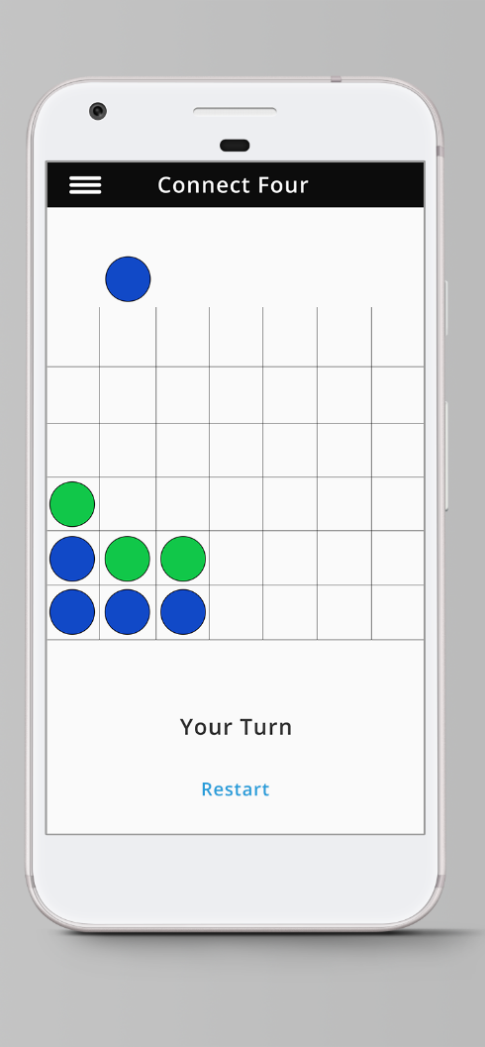
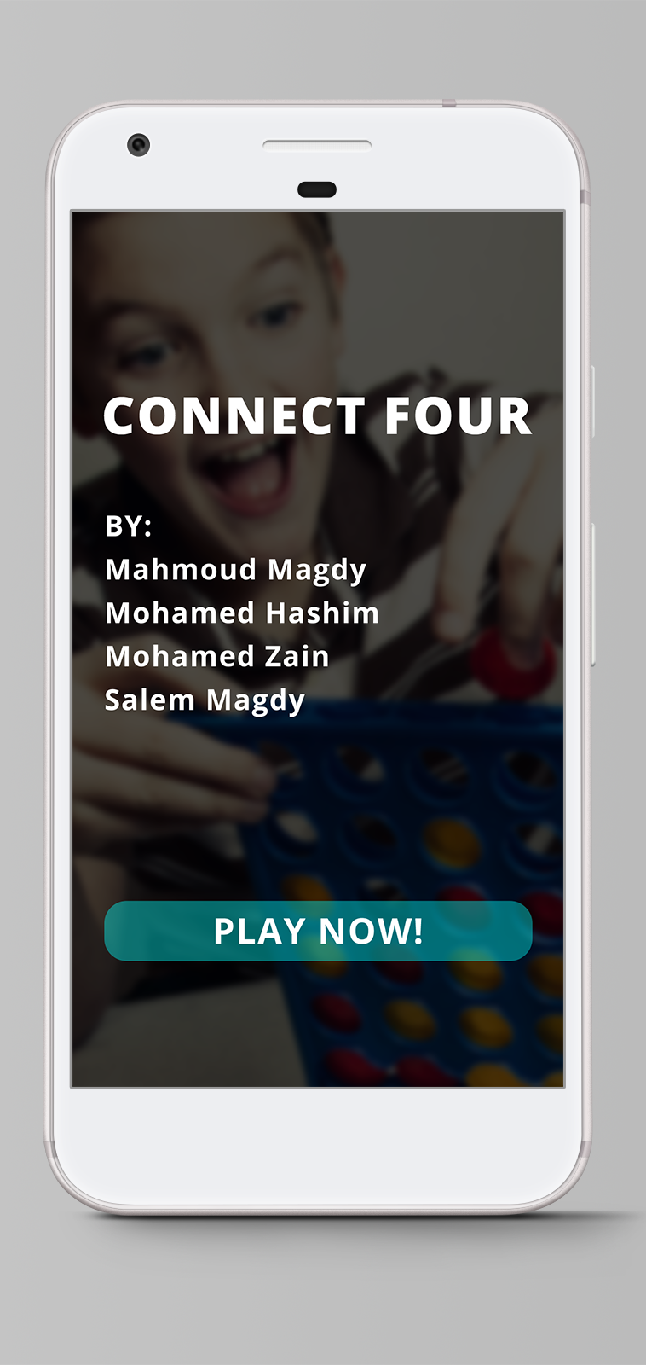
Environment

Slide 5
Used techniques
MinMax Algorithm (Negamax variant)
Bitmap representation to make all the computations using bitwise operations
Alpha-Beta pruning
Iterative deepening combined with Binary Search
Traversing reordering using cost computations
Transportation table (Simple hashing technique)

